Slide 1

Comparative Analysis of Relational and Non-Relational Databases

Slide 2

Introduction
This presentation provides a comparative analysis of relational and non-relational databases. We will explore their characteristics, use cases, and advantages to understand their applications in modern data management

Slide 3

Relational Databases Overview
Relational Databases Overview
Relational databases are structured to store data in tables with predefined schemas.
They utilize SQL for querying and ensure data integrity through ACID properties, making them suitable for complex transactions.

Slide 4

Non-Relational Databases Overview
Non-relational databases, often called NoSQL, are designed for flexibility and scalability.
They can store data in various formats such as documents, key-value pairs, or graphs, allowing for dynamic data

Slide 5

Key Characteristics
Relational databases emphasize structured data and
relationships, while non-relational databases focus on flexibility and scalability.
Understanding these characteristics helps in selecting the right database for specific needs.

Slide 6

Use Cases for Relational Databases
Relational databases are ideal for applications requiring transactional integrity, such as banking systems and enterprise resource planning (ERP).
They excel in scenarios where data relationships are crucial.

Slide 7

Use Cases for Non-Relational Databases
Non-relational databases are well-suited for big data applications, real-time analytics, and content management systems.
Their ability to handle diverse data types makes them popular in web and mobile applications.

Slide 8

Advantages of Relational Databases
The main advantages of relational databases include data integrity, structured querying with SQL, and robust transaction support.
These features are essential for applications that require precise data management.

Slide 9

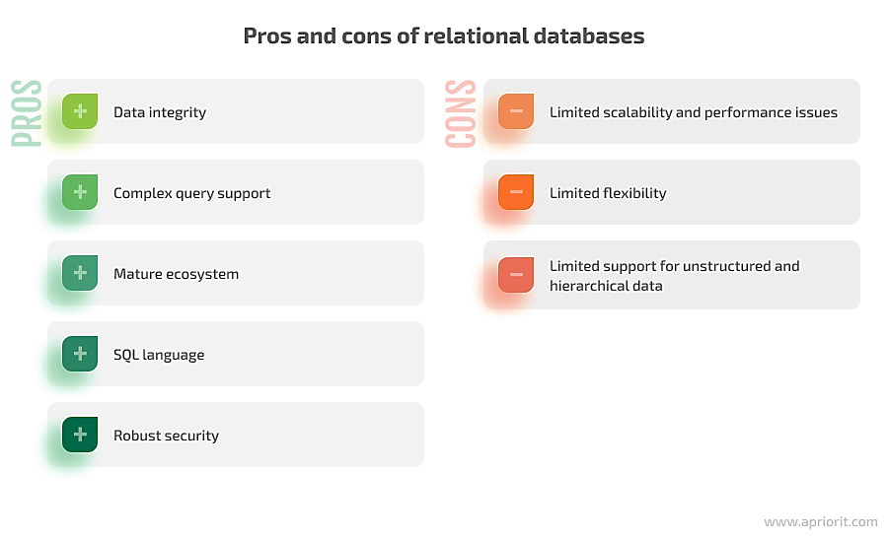
Pros and Cons of Relational Databases

Slide 10

Advantages of Non-Relational Databases
Non-relational databases offer high scalability, flexibility in data modeling, and the ability to handle large volumes of unstructured data.
These benefits cater to modern applications needing rapid growth and adaptability.

Slide 11
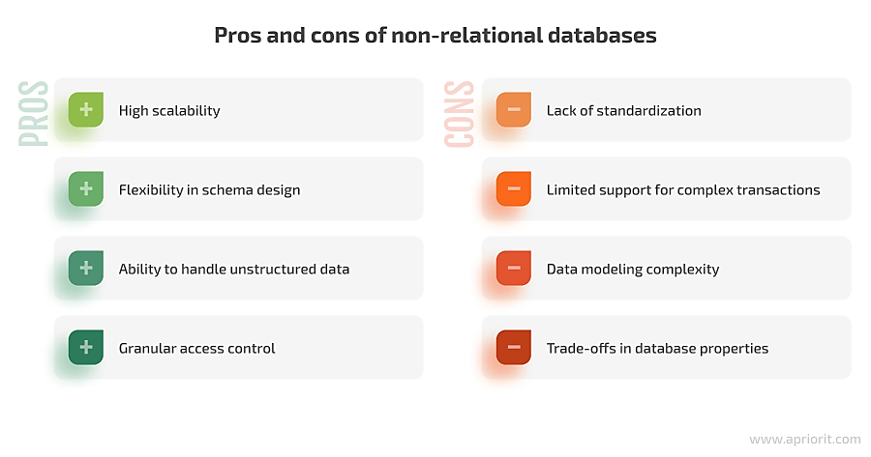
Pros and Cons of Non – Relational database

Slide 12
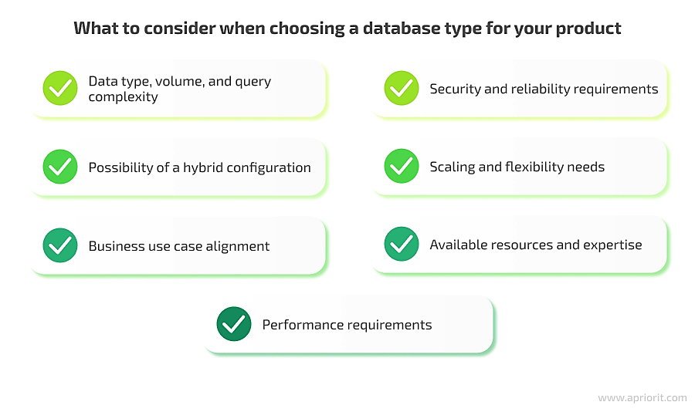
What to consider when choosing a database type for your product

Slide 13

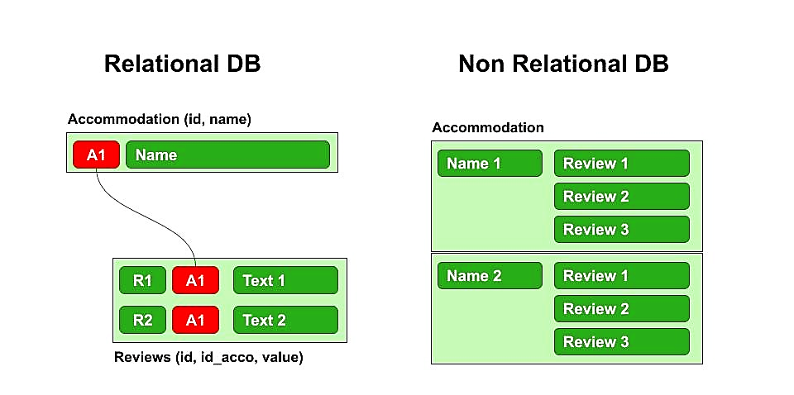
Relational DB vs Non Relational DB

Slide 14
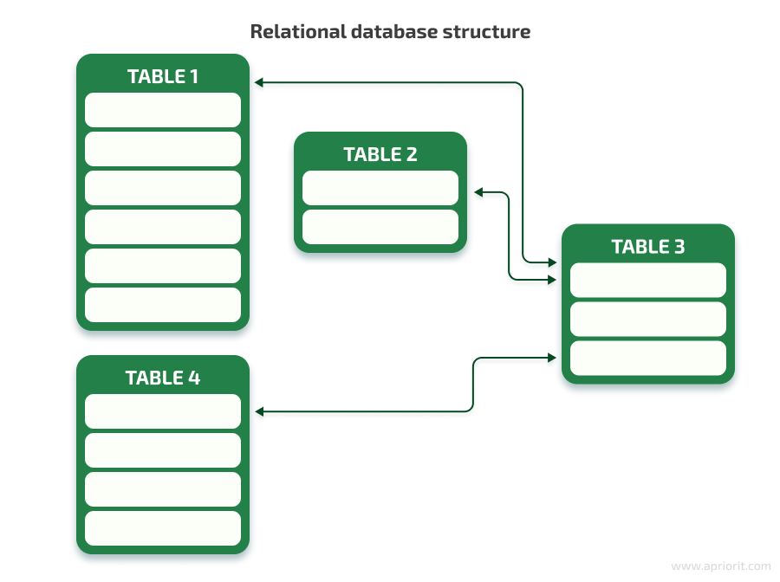
Relational data base Structure

Slide 15
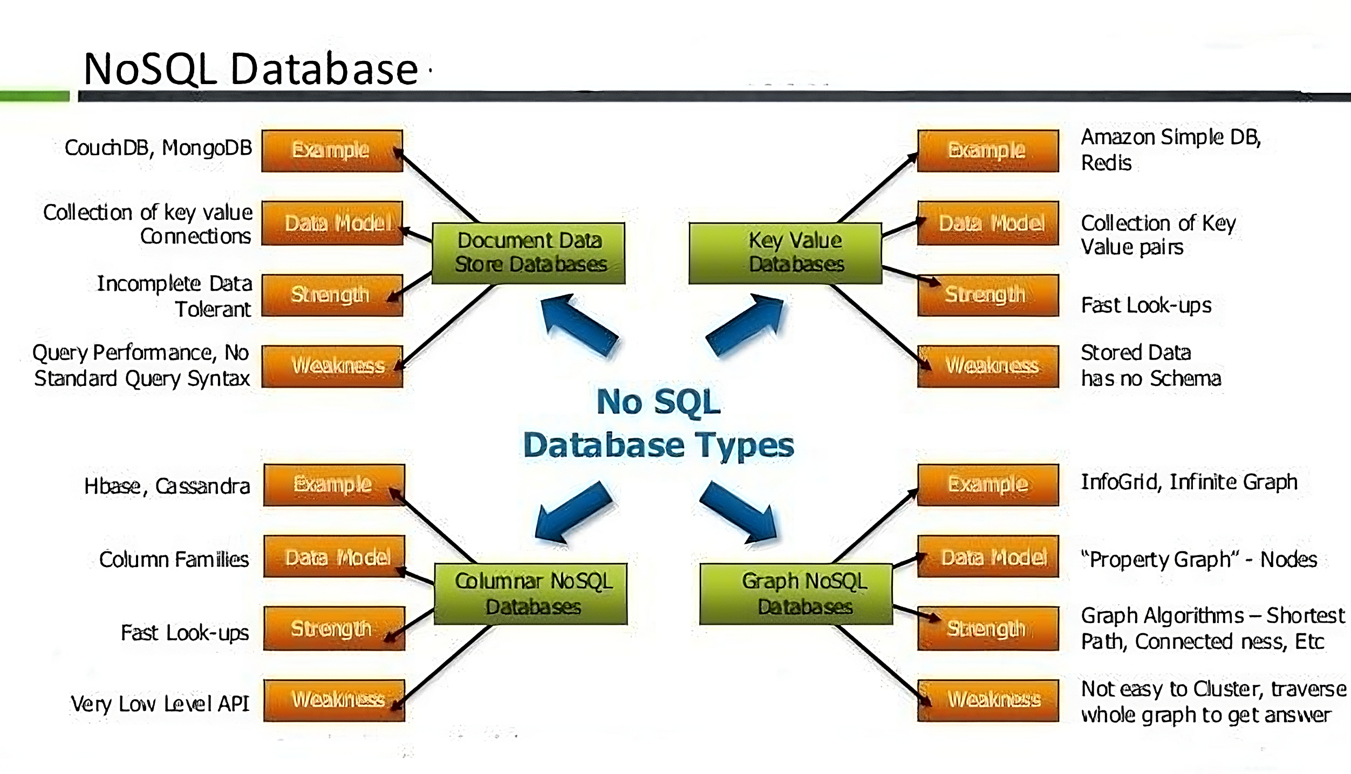
NoSQL Database

Slide 16
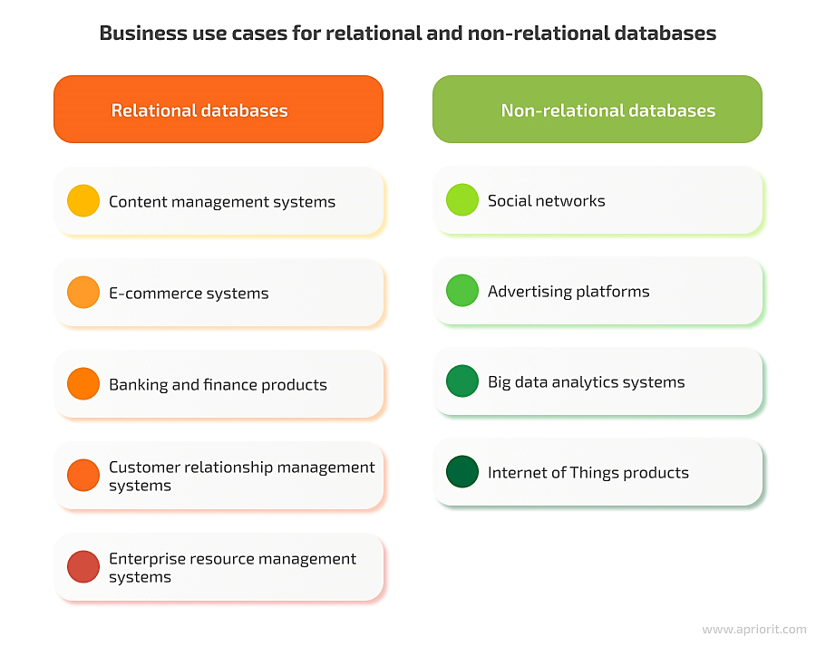
Business Use Cases for Relational and Non-Relational Databases

Slide 17
References
Date, C. J. (2004). "An Introduction to Database Systems." 8th Edition. Addison-Wesley.
Stonebraker, M., & Çetintemel, U. (2005). "One Size Fits All: An Idea Whose Time Has Come and Gone." In Proceedings of the 21st International Conference on Data Engineering.
MongoDB Documentation. (n.d.). "What is NoSQL?" Retrieved from MongoDB
Elmasri, R., & Navathe, S. B. (2015). "Fundamentals of Database Systems." 7th Edition. Pearson.

